Slide 1
BAYESIAN INVERSION FOR POROSITY AND WATER SATURATION

Slide 2
Introduction
The elastic properties of fluid-saturated rocks are known to vary with frequency[1], and a goal of current research is to use this fact to improve estimation of fluid properties from seismic data. Frequency-dependent effects are often particularly pronounced for rocks containing gas. Frequency-dependent effects can be studied either through direct measurements of attenuation or through frequency dependent reflectivity associated with high values of velocity dispersion. The basis of techniques is measuring the cumulative loss of energy during transmission through an attenuating zone.

Slide 3
This study takes the latter approach, and builds on the work of Wilson[2] who related frequency-dependent amplitude-versus-offset (FAVO) effects to seismic dispersion. Our goal is to understand the possible use of FAVO to determine rock and fluid properties, with a particular emphasis on porosity and gas saturation.
Estimation of gas saturation from AVO is a difficult and long standing problem, but recent studies have suggested that frequency-dependent effects have the potential to provide a new approach. In this paper we describe a new Bayesian strategy for analyzing data on the basis of frequency-dependent rock physics models.
we will also develop a different approach to get a generative model using linear regression along with inverse probability.

Slide 4
Amplitude versus offset (AVO)/(FAVO)
Amplitude versus offset (AVO) or amplitude variation with offset is the general term for referring to the dependency of the seismic attribute, amplitude, with the distance between the source and receiver (the offset). AVO analysis is a technique that geophysicists can execute on seismic data to determine a rock's fluid content, porosity, density or seismic velocity, shear wave information, fluid indicators (hydrocarbon indications).[12]

Slide 5
Rock Physics Modelling
Rock physics modelling aims to provide a link between rock properties, such as porosity, lithology, and fluid saturation, and elastic attributes, such as velocities or impedances. These models are then used in quantitative seismic interpretation and reservoir characterization.

Slide 6
Bayesian Data Analysis
It is a method of analysing data. It is when you use probability to represent uncertainty in all parts of a statistical model.
A flexible extension of maximum likelihood.
Potentially the most information efficient method to fit a statistical model.
It is method of figuring out unknowns that require three things:
Data
A generative model
Priors

Slide 7
Data
Data that we deal with can be simply a list of numbers like height of person, data can be pair of numbers like height and weight of a person, data can be complex like list of lists. So to deal with these kind to complex data we need smart approach, Bayesian data analysis is one of it.
A generative model
A generative model is any mathematical expression or any probability distribution that takes input processes it and give some output. It is also known as likelihood function.
Parameters
Parameters are constants that we see in probability distribution. Tweaking those parameters, we can change the probability distribution.

Slide 8
Prior
This is the information that the model has before seeing the data. For example in the above case prior to calculation of F(X) if distribution X is known it would be great.
Bayes Theorem
Consider two events, A and B. Let us designate the discrete probability of each event happening by P(A) and P(B). The probability of both A and B happening, designated as the joint probability P(A, B) [or P(A and B)], is given by
P(A, B)= P(A|B)P(B)= P(B| A)P(A)
P(B| A)= P(A|B)P(B) P(A)

Slide 9
Bayesian inference
If we know the parameters we can simply plug in those parameters into generative model and can simply can get the data that we want.[8]
But what if we already know the data and we want to find out parameters or more specifically probability distribution of parameters?
Here bayesian inference comes into picture. When we know the data and want to calculate the probability distribution of parameter we use inverse probability or bayesian inference.

Slide 10
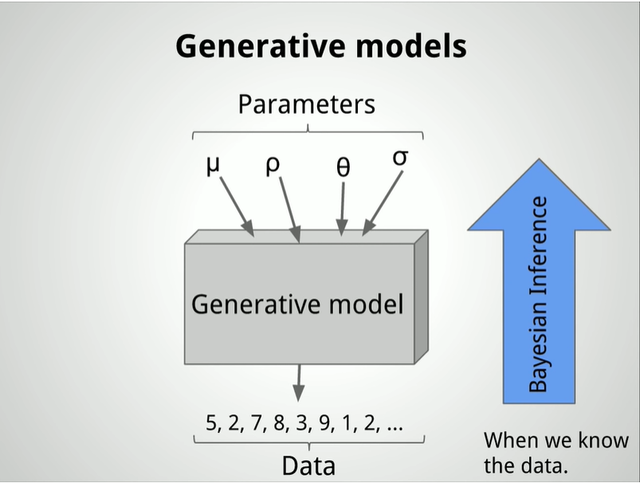
If we know the parameters

Slide 11
Suppose a person wants to sell a product and he tests it on 16 randomly selected people out of which 6 purchased the product. Now he wants to find out that if he sells product to 10,000 people what percentage of people would buy the product.

Slide 12
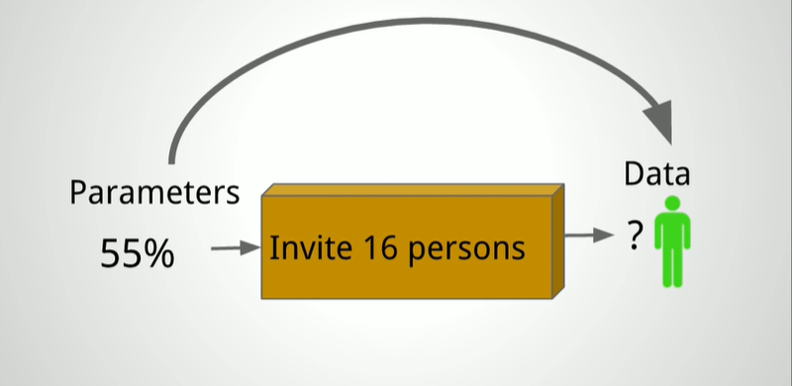

Things that we require:
Data- Yes, we have 6/16
A Generative model:
When we ask a person whether he wants to buy the subscription or not the answer would be yes or no and let chance of yes be 55%.

Slide 13
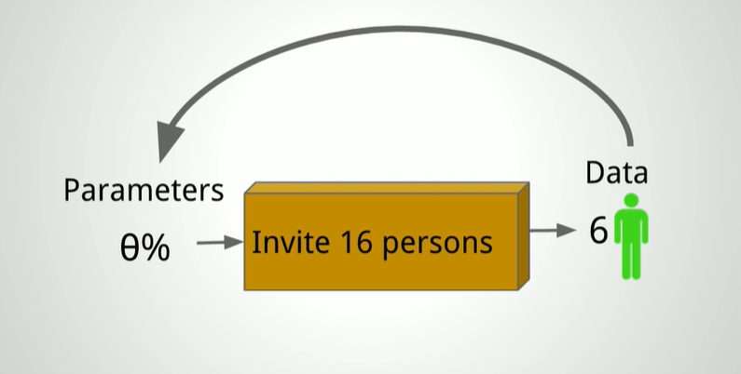
Prior- What information the model has before seeing the data. That is we need to have information about parameter space.

Slide 14
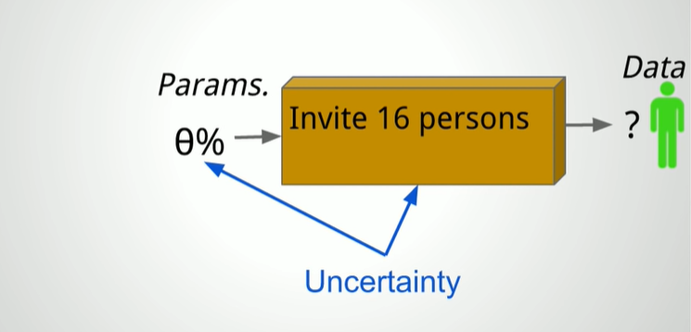
Now we can finally apply bayesian data analysis / bayesian inference.
But we before that we need to use probability to represent uncertainty in all parts of the model.
Here we can see uncertainty in two places.
Uncertainty in generative model- we do not know what would be the simulated data each time we run it.
Uncertainty is implicitly represented as probability distribution.
Generative model is a binomial distribution.
Uncertainty in parameter- we assume that prior to seeing any data, then parameter value is unif(0,1) and any value between 0 to 100% is equi-likely.

Slide 15
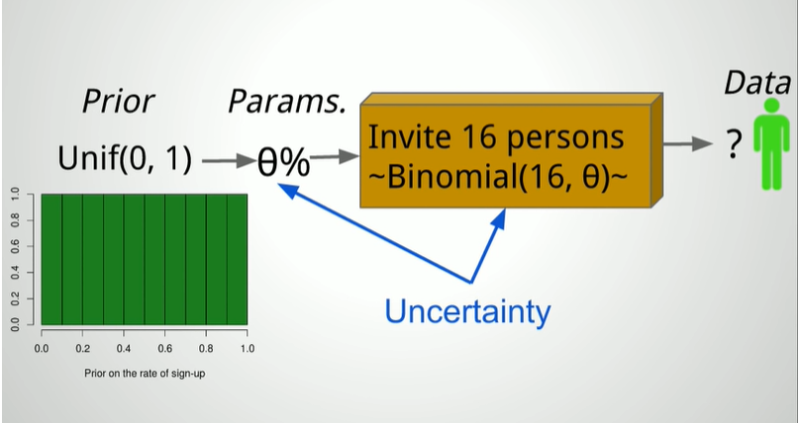

Slide 16
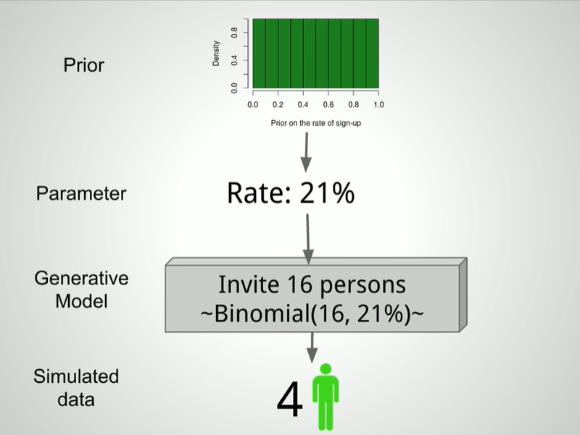
STEP 1: First we draw a random parameter from PRIOR DISTRIBUTION. STEP 2: Then we feed that data into generative model and get simulated data.

Slide 17
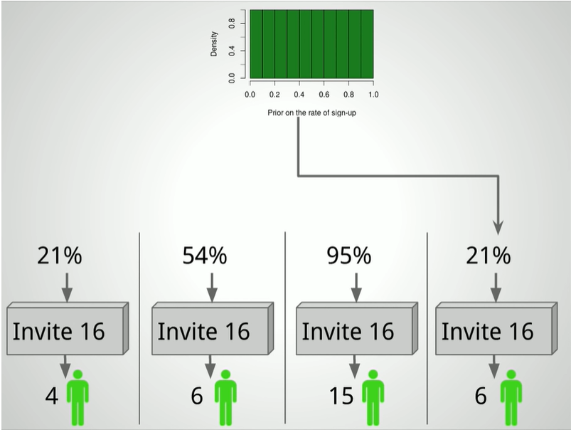
STEP 3: We run it 100000 times and get simulated data. Only 4 draws are shown.

Slide 18
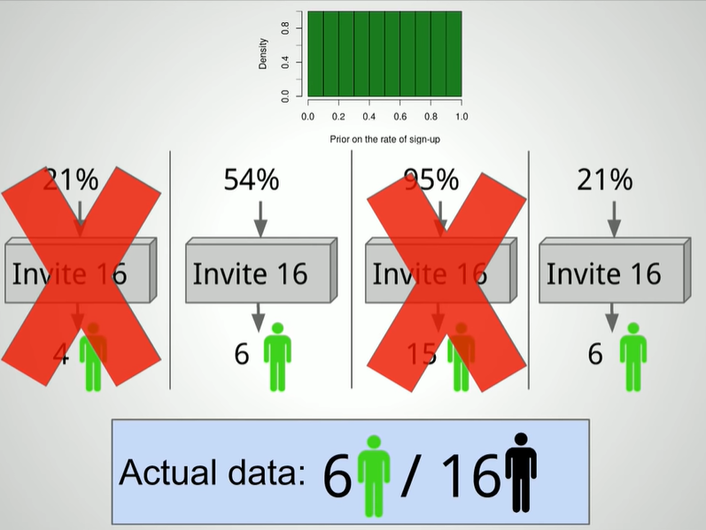
STEP 4: Now we bring in the data that we have. We know that 6 out 16 people bought the item.

Slide 19
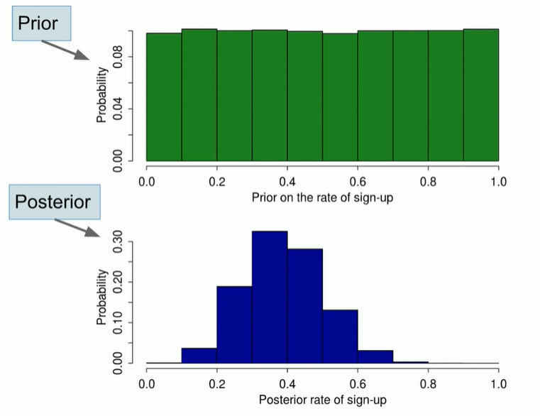
STEP 5: This is what we want. This is the POSTERIOR DISTRIBUTION. After plotting the histogram of remaining parameters we will get desired output.

Slide 20
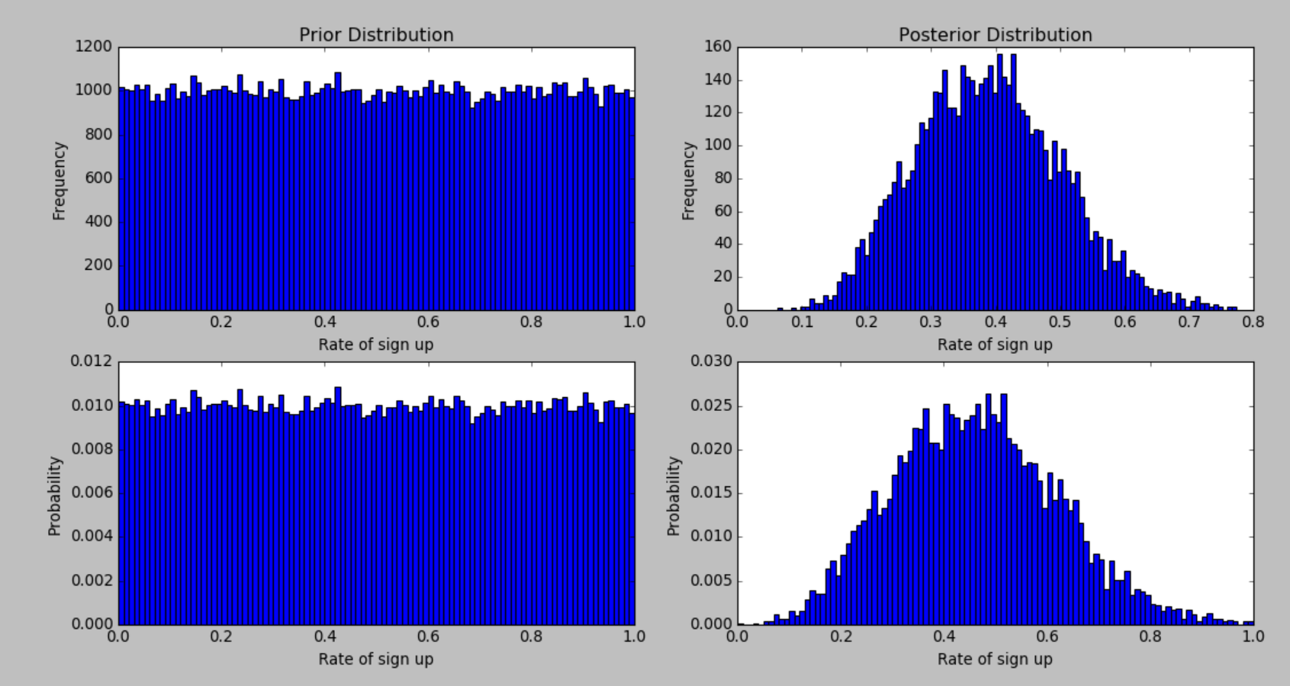
Number of draws left: 5910, Posterior mean: 0.389, Posterior median: 0.386, Posterior 95% quantile interval: 0.186-0.622, highest probability: 0.026, corresponding interval: 0.480-0.490.

Slide 21
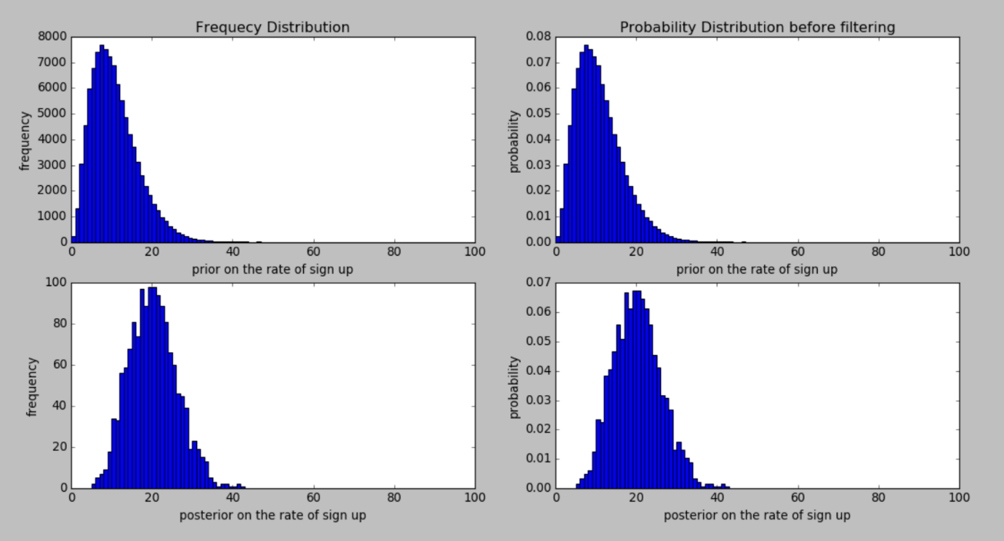
Informative Prior

Slide 22
Implementation- Inversion of porosity and water saturation
For implementing our bayesian model we need 3 thing
Data
Generative model
Prior Distribution
For bayesian analysis a necessary condition in that uncertainty in each part of our model should be represented as probability distribution.

Slide 23
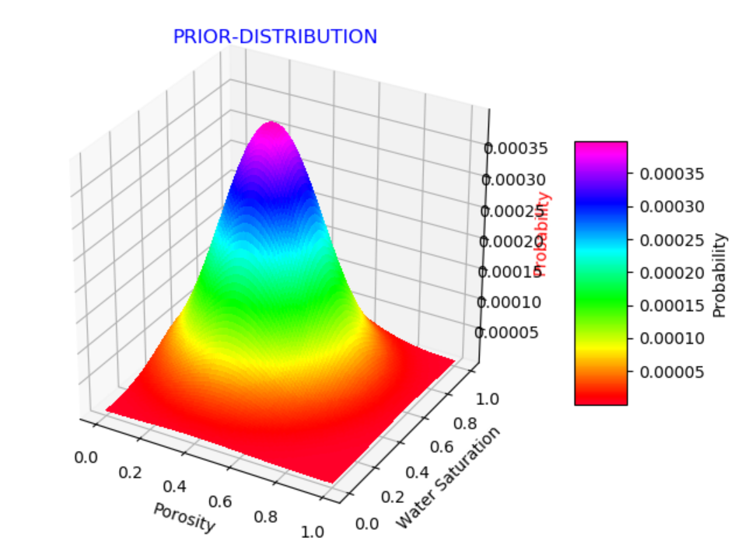
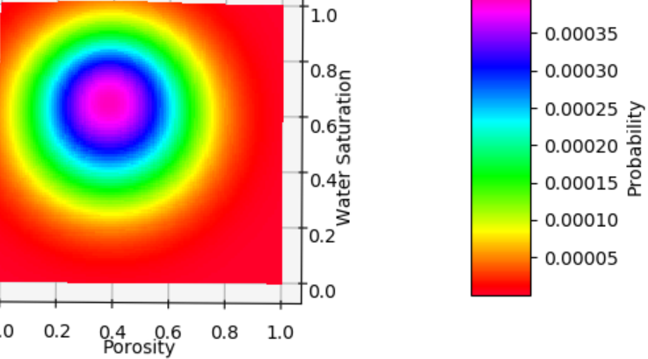
Prior distribution
Normal distributions of N(0.1, 0.25) for porosity and N(0.9, 0.25) for water saturation are assumed respectively as the prior information. As both are assumed to independent of each other joint probability estimation is considered as bivariate normal distribution with co-relation factor to be zero.

Slide 24
Generative Model
Generative model is basically a probability distribution that gives probability of getting a particular data given a particular parameter.

Slide 25
Generative model 1
Step 1: Calculation of Frequency-Dependent Reflectivity
For each pair of porosity and water saturation, calculate reflectivity at each angle of incidence and frequency.
r =r(θi, fj)
fj = 10,20,30,40,50 Hz.
θi = 0-30 degree with step of 1 degree.
So for each porosity and water saturation we will get 155 reflectivities.

Slide 26
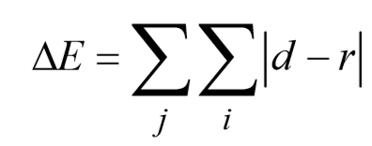
Step 2: Spectral Decomposition And Balancing
Spectrally decomposing and balancing pre-stack data along the reservoir position to obtain the spectral amplitudes d varying with angle of incident θi at frequencies fj, i.e.,
d=d(θi, fj)
Step 3: Calculating mis-fit
Comparing r with d and calculating the misfits between them. This provides a basis for an inversion of the data in terms of petrophysical parameters.
So for each pair of porosity and water saturation we will get a mis-fit(delta E).

Slide 27
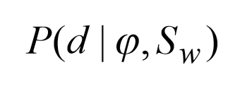
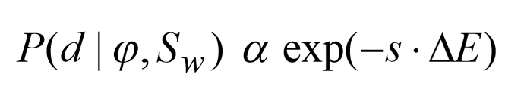
Step 4: Deriving Generative Model
Generative model is basically a probability distribution that gives probability of getting a particular data given a particular parameter.
So we have to find:

Slide 28
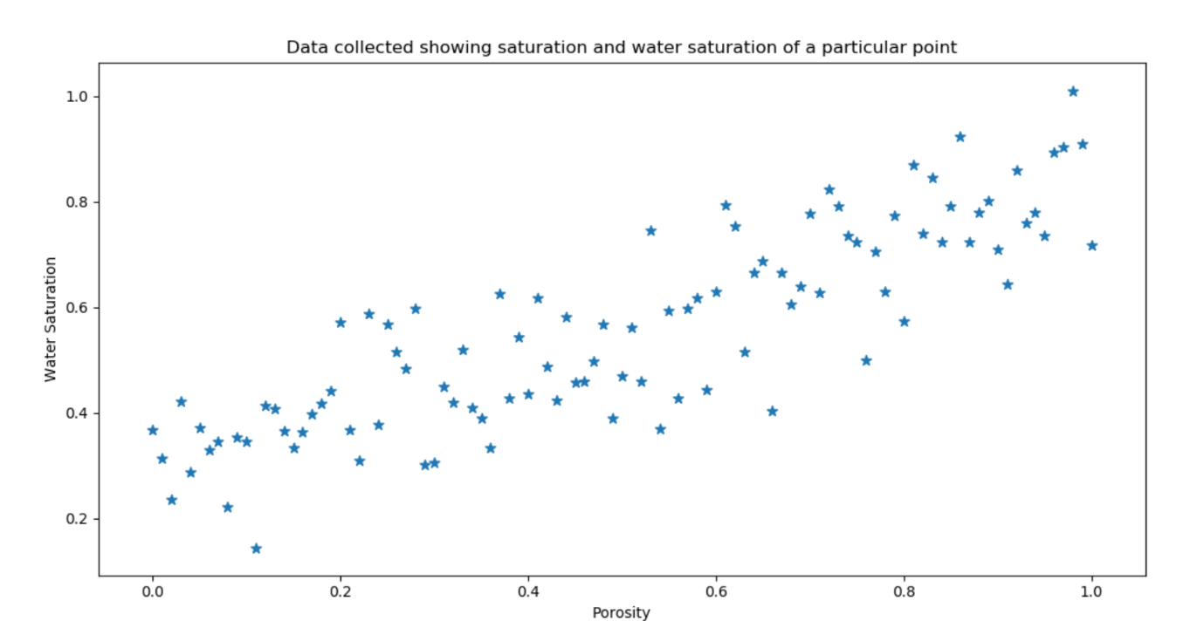
Generative model 2
We can see that water saturation and porosity shows a certain trend, they are not uniformly distributed rather they show a certain distribution. It seems they normally distributed with mean following a line in the plane.
We have used linear regression with find how the mean of this normal distribution is distributed.

Slide 29
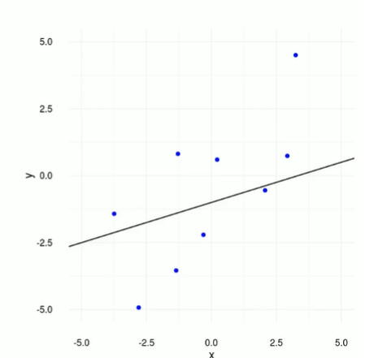
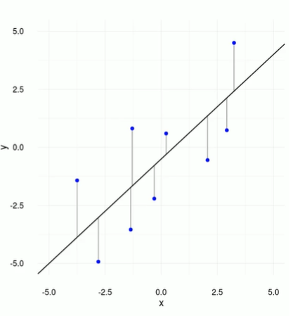
The dark black line shows how the mean of the normal distribution is changing with Water saturation and porosity.
Now as this is not a classical linear regression rather we have to incorporate probability here. Because the basic condition of bayesian data analysis is that we should represent uncertainty in each part of our model in form of probability distribution.

Slide 30
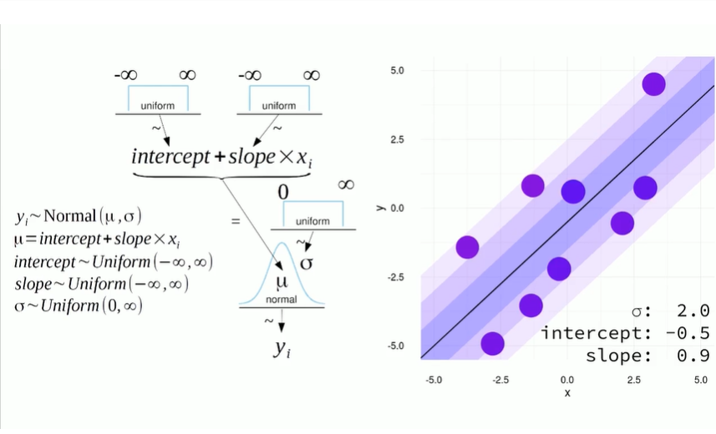

Slide 31
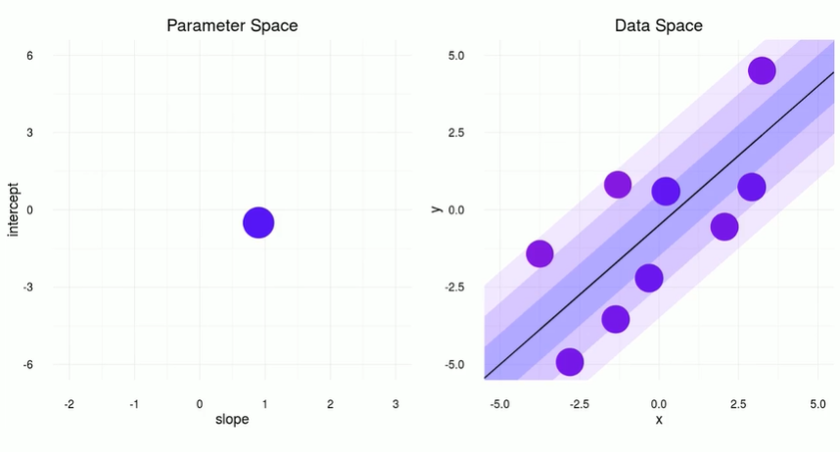
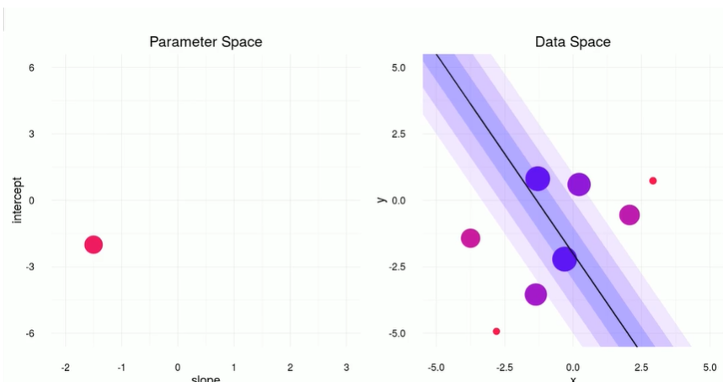
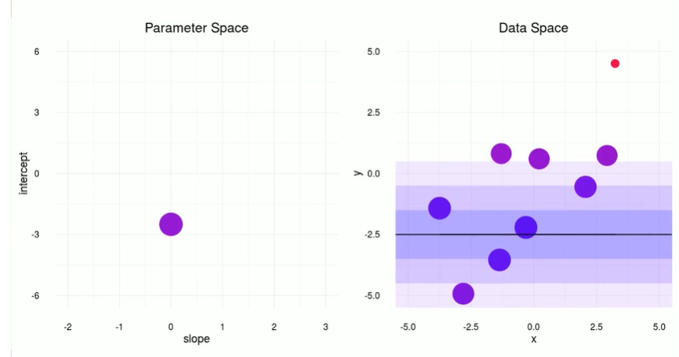
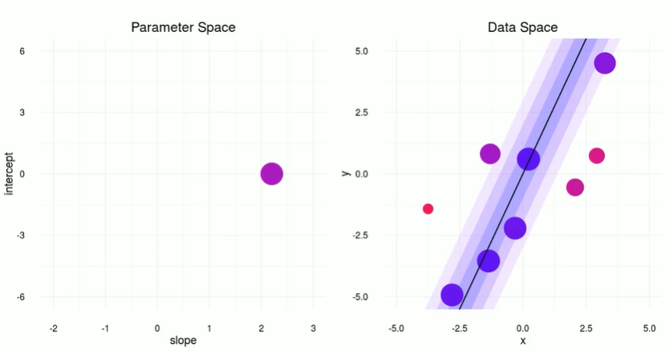

Slide 32
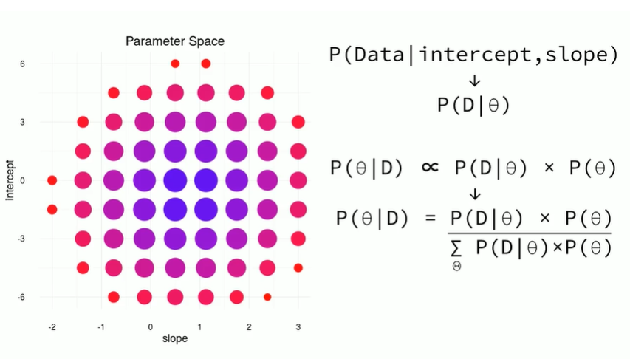
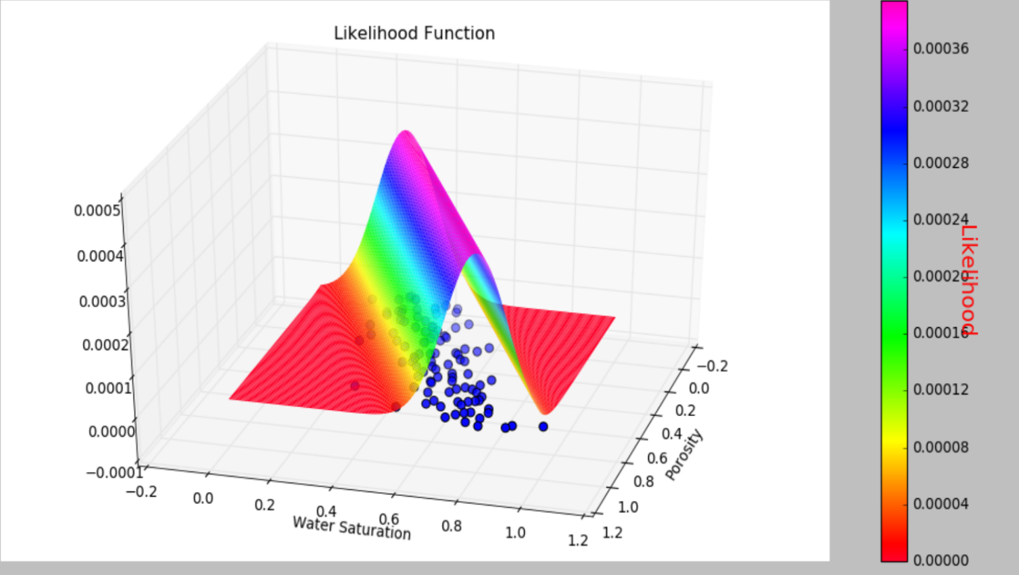
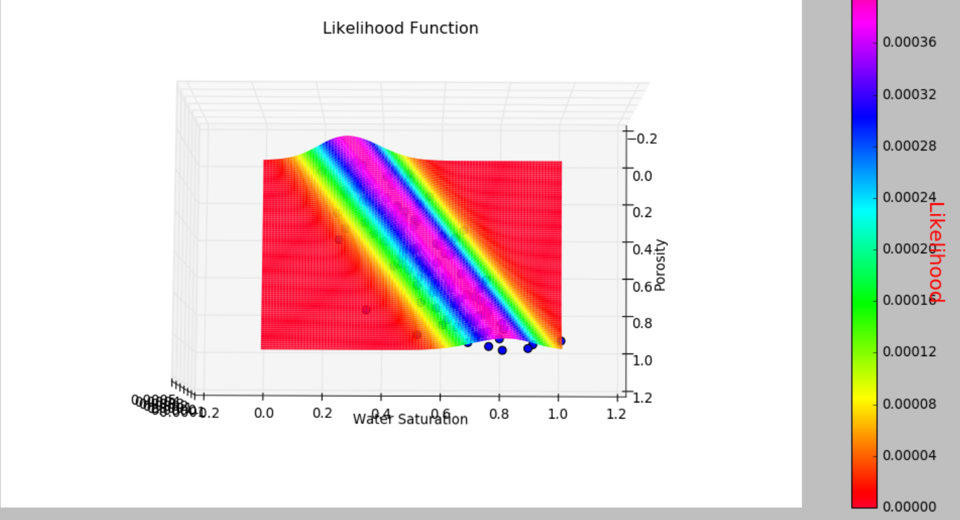

Slide 33
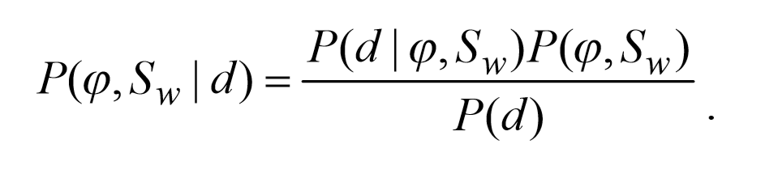
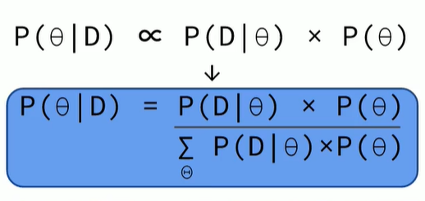
Posterior Distribution
From prior distribution
From Generative Model

Slide 34
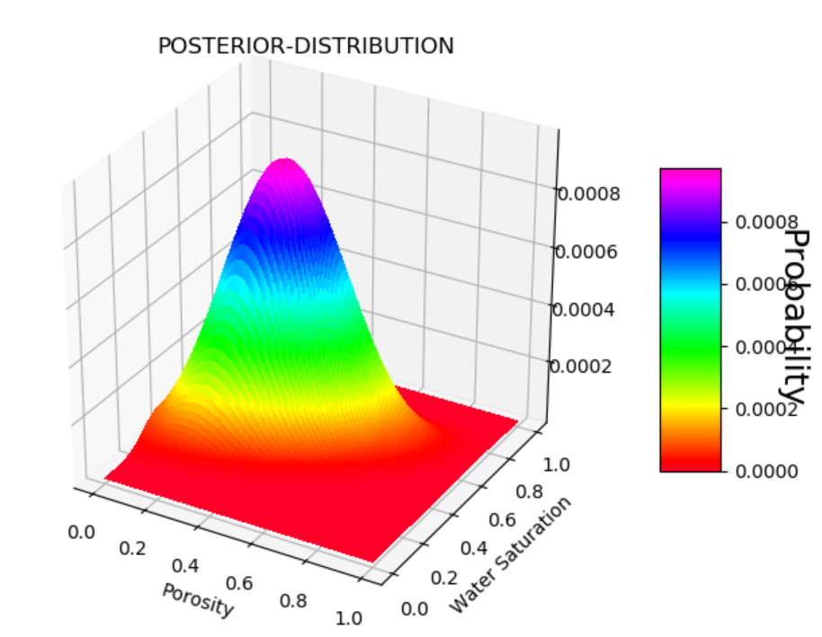
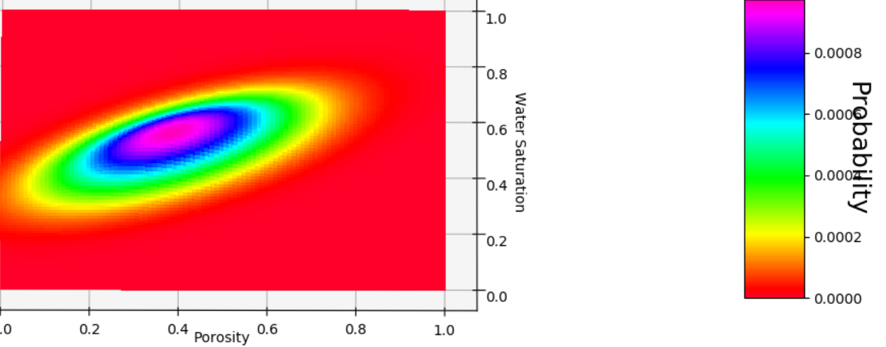

Slide 35
Conclusion
This paper has presented a methodology for combining Bayes inversion with linear regression modeling to improve estimation of porosity and gas saturation from seismic data. We have demonstrated theoretically that use of bayesian data analysis has the potential to improve resolution of rock and fluid properties compared to the standard frequency-independent techniques. We applied the method to field data, calibrated the model and were able to derived probability distributions of porosity and saturation for zones which have yet to be drilled. Possible sources of uncertainty include the effect of layer thickness and variations in the caprock properties. Overall, we believe that our method has the potential to improve the estimation of petrophysical parameters from seismic data. We also believe that our method has the potential to improve the estimation of petrophysical parameters of an area buy knowing petrophysical parameters at some points.
We have achieved our main objective of reducing the uncertainty.

Slide 36
References
[1] Batzle M.L., Han D.-H. and Hofmann R. 2006. Fluid mobility and frequency-dependent seismic velocity, direct measurements. Geophysics 71(1), N1–N9. Biot M.A. 1956a.
[2] Wilson, A., M. Chapman, and X.-Y. Li, 2009, Frequency-dependent AVO inversion: 79th Annual International Meeting, SEG, Expanded Abstracts, 341–345.
[3] White, J. E., 1975, Computed seismic speeds and attenuation in rocks with partial gas saturation: Geophysics, 40, 224–232.
[4] Chapman, M., E. Liu, and X.-Y. Li, 2005, The influence of abnormally high reservoir attenuation on the AVO signature: The Leading Edge, 24, 1120–1125.
[5] Innanen, K. A., 2012, Anelastic P-wave, S-wave and Converted-wave AVO Approximations: 74th Annual International Conference and Exhibition, EAGE, Extended Abstracts, P197.
[6] Chapman, M., S. V. Zatsepin, and S. Crampin, 2002, Derivation of a microstructural poroelastic model: Geophysical Journal International, 151, 427–451.
[7] Wu, X., and T. Liu, 2009, Spectral decomposition of seismic data with reassigned smoothed pseudo Wigner-Ville distribution: Journal of Applied Geophysics, 68, 386–393.
[8] https://www.youtube.com/watch?v=3OJEae7Qb_o
[9] Wu X., Chapman M., Li X.-Y., Angerer E. and Boston P. 2013. Bayesian inversion for porosity and saturation using frequencydependent rock physics models. 83rd Annual SEG Meeting, Expanded Abstracts, 3057–3061.
[10] Quantitative gas saturation estimation by frequency-dependent amplitude-versus-offset analysis doi: 10.1111/1365-2478.12179
[11] https://www.youtube.com/watch?v=Ie-6H_r7I5A
[12] Wikipedia

